Slide 1
Discrete Mathematics
Xiaowei Yang
South China University of Technology

Slide 2
Chapter 7. Trees
Introduction to Trees
Section 7.1

Slide 3
Contents
1
Introduction to Trees
2
Trees as Models
3
Properties of Trees

Slide 4
Introduction to Trees

Slide 5
Trees
A connected graph that contains no simple circuits is called a tree.
Tree were used as long ago as 1857 by English mathematician Arthur Cayley used them to count certain types of chemical compounds.
Trees are particularly useful in computer science, where they are employed in a wide range of algorithms.

Slide 6
An Example of Trees
Nikolaus
1623-1708
Jacob I
Nikolaus
Johann I
1654-1705
1662-1716
1667-1748
Nikolaus I
Nikolaus II
Daniel
Johann II
1687-1759
1695-1726
1700-1782
1710-1790
Johann III
Jacob II
1746-1807
1759-1789

Slide 7
Definition 1
A tree is a connected undirected graph with no simple circuits.
Example 1 Which of the graph are trees?
a
b
a
b
d
d
c
c
e
f
e
f
G1
G2

Slide 8
a
b
a
b
d
c
d
c
e
f
e
f
G3
G4
Circuits
Unconnected

Slide 9
Forrest
Any graph (not necessary connected) that contains no simple circuits is called a forest.
a
b
c
d
e
f
G4

Slide 10
Tree and Forest Examples
A Tree:
A Forest:
Leaves in green, internal nodes in brown.

Slide 11
Forest

Slide 12
Theorem 1: An undirected graph is a tree if and only if there is a unique simple path between any two of its vertices.
Proof :
(1) Assume that T is a tree. Then, T is connected with no simple circuits.
Let x and y be two vertices of T.
Since T is connected, there is a simple path between x and y.

Slide 13
Proof of Theorem
Moreover, this path must be unique. Otherwise, if there is a second such path, the path formed by combining the first path from x to y with the path from y to x , which obtained by reversing the order of the second path from x to y, will form a circuit.
This implies, that there is a simple circuit in T. Hence, there is a unique simple path between any two vertices of a tree.

Slide 14
Proof of Theorem
(2)Now assume that there is a unique simple path between any two vertices of a graph T. Then T is connected, since there is a path between any two of its vertices.
Furthermore, T can have no simple circuits.
To see that this is true, suppose T has a simple circuit that contained the vertices x and y.
Then there would be two simple paths between x and y, since the simple circuit is made up of a simple path from x to y and a second simple path from y to x. The proof is finished.

Slide 15
Rooted Tree
Definition 1: A rooted tree is a tree in which one vertex has been designed as the root and every edge is directed away from the root.
Rooted trees can also be defined recursively. We can change an unrooted tree into rooted tree by choosing any vertex as the root. Note that different choices of the root produce different rooted trees.

Slide 16
Rooted Tree Examples
Note that a given unrooted tree with n nodes yields n different rooted trees.
Same tree
except
for choice
of root
root
root

Slide 17
Rooted-Tree Terminology Exercise
Find the parent,
children, siblings,
ancestors, &
descendants
of node f.
o
n
h
r
d
m
b
root
a
c
g
e
i
q
f
p
j
k
l

Slide 18
Example 2
In the rooted tree T (with root a), find the parent of c, the children of g, the sibling of h, all ancestors of e, all descendants of b, all interval vertices, and all leaves.
What is the subtree rooted at g?

Slide 19
a
b
f
g
g
c
h
i
j
h
i
j
d
e
k
l
m
k
l
m

Slide 20
n-ary trees
A rooted tree is called n-ary if every vertex has no more than n children.
  It is called full if every internal (non-leaf) vertex has exactly n children.
A 2-ary tree is called a binary tree.
  These are handy for describing sequences of yes-no decisions.
  Example: Comparisons in binary search algorithm.

Slide 21
Example 3
Are the rooted trees full m-ary trees for some positive integer m ?
T1 is a full binary tree since each of its internal vertices has two children.

Slide 22
Example 3
T2 is a full 3-ary tree since each of its internal vertices has three children.

Slide 23
Example 3
In T3 each interval vertex has five children, so T3 is a full 5-ary tree.

Slide 24
T4 is not a full m-ary tree for any m since some of its internal vertices have two children and others have three children.

Slide 25
Ordered Rooted Tree
This is just a rooted tree in which the children of each internal node are ordered.
In ordered binary trees, we can define:
  left child, right child
  left subtree, right subtree
For n-ary trees with n>2, can use terms like “leftmost”, “rightmost,” etc.

Slide 26
a
h
i
b
c
l
d
e
h
i
j
k
l
m
f
g
j
k
m
The left child of d is f and the right child is g. We show the left and right subtree of c.

Slide 27
Graph Models

Slide 28
Trees as Models
Can use trees to model the following:
  Saturated hydrocarbons
  Organizational structures
  Computer file systems
In each case, would you use a rooted or a non-rooted tree?

Slide 29
Example 5: Saturated hydrocarbons
Graphs can be used to represent molecules, where atoms are represented by vertices and bonds between them by edges.

Slide 30

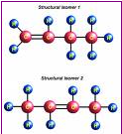

Example 5: Saturated hydrocarbons

Slide 31
Example 6: Representing Organization
The structure of a large organization can be modeled using a rooted tree. Each vertex in this tree represents a position in the organization.
An edge from one vertex to another indicates that the person represented by the initial vertex is the direct boss of the person represented by the terminal vertex.

Slide 32
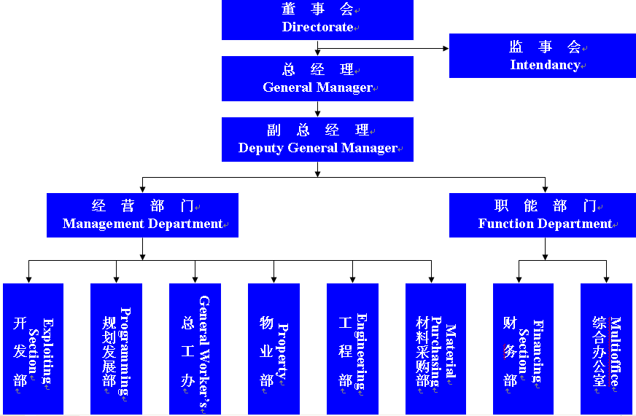

Slide 33
Example 7: Computer File System
Files in computer memory can be organized into directories.
A directory can contain both files and subdirectories.
The root directory contains the entire file system.
A file system may be represented by a rooted tree, where the root represents the root directory, interval represent subdirectories, and leaves represent ordinary files or empty directories.

Slide 34
Example 8: Tree-Connected Parallel Processors
A tree-connected network is another important way to interconnect processors.
The graph representing such a network is a complete binary tree.
Such a network interconnects n = 2^k – 1 processors, where k is a positive integer.
We will illustrate how a tree-connected network can be used for parallel computation.

Slide 35
Properties of Trees

Slide 36
Theorem 2: A tree with n vertices has n-1 edges.
Proof: We will use mathematical induction. Note that for all the trees here we can choose a root and consider the tree rooted.
(1) When n=1, a tree with n=1 vertex has no edges. It follows that the it is true for n=1.
(2) The induction hypothesis states that every tree with k vertices has k-1 edges, where k is a positive integer.

Slide 37
Suppose that a tree T(k+1) has k+1 vertices and that v is a leaf of T(k+1), and let w be the parent of v.
Removing from T(k+1) the vertex v and edge connecting w to v produces a tree T(k) with k vertices, since the resulting graph is still connected and has no simple circuits.
By the induction hypothesis, T(k) has k-1 edges.
It follows that T(k+1) has k edges since it has one more edge than T(k), the edge connecting v and w.

Slide 38
Theorem 3: A full m-ary tree with i interval vertices contains n=m*i+1 vertices.
Proof: Every vertex, except the root, is the child of an interval vertices has m children, there are m*I vertices in the tree other than the root.
Therefore, the tree contains n=m*i+1 vertices.

Slide 39
Theorem 4: A full m-ary tree with
(i) n vertices has i=(n-1)/m interval vertices and l=[(m-1)*n+1]/m leaves,
(ii) i interval vertices has n=m*i+1 vertices and l=(m-1)*i+1 leaves,
(iii) l leaves has n=(m*l-1)/(m-1) vertices and i=(l-1)/(m-1) interval vertices.

Slide 40
Theorem 4: A full m-ary tree with
(i) n vertices has i=(n-1)/m interval vertices and l=[(m-1)*n+1]/m leaves,
Proof: Let n represent the number of vertices, I the number of interval vertices, and l the number of leaves.
Solving for i in n=m*i+1 gives i=(n-1)/m.
Then inserting this expression for i into the equation n=l+i shows that
l=n-i=n-(n-1)/m=[(m-1)*n+1]/m.

Slide 41
Theorem 4: A full m-ary tree with
(ii) i interval vertices has n=m*i+1 vertices and l=(m-1)*i+1 leaves,
Proof: Because n = l + i and n=m*i+1 according to Theorem 3,
l + i = m*i + 1. Hence, l = m*i - i + 1=(m-1)*i+1.

Slide 42
Theorem 4: A full m-ary tree with
(iii) l leaves has n=(m*l-1)/(m-1) vertices and i=(l-1)/(m-1) interval vertices.
Proof: Because n = l +i, i = n – l.
Because l = (m-1)*i + 1 according to (ii),
l = (m-1)*(n-1) + 1. Hence, n = (ml - 1) / (m - 1).
Because l = [(m - 1)*n + 1] / m, i = (l - 1) / (m - 1).

Slide 43
Example 9
Suppose that someone starts chain letter.
Each person who receives the letter is asked to send it to four other people.
Some people do this, but others do not send any letters.
How many people have seen the letter, including the first person, if no one receives more than one letter and if the chain letter ends after there have been 100 people who read it but did not send it out ?
How many people sent out the letter?

Slide 44
Example 9
Solution: The chain letter can be represented using 4-ary tree. The internal vertices correspond to people who sent out the letter, and the leaves correspond to people who did not send it out.
Since 100 people did not send out the letter, the number of leaves in this rooted tree is l = 100.
Hence, part (iii) of Theorem 4 shows that the number of internal vertices is 133 – 100 =33, so that 33 people sent out the letter.

Slide 45
Some terminates
It is often desirable to use rooted trees that are “balanced” so that the subtrees at each vertex contain path approximately the same length.
Some definitions will make this concept clear.
The level of a vertex v in a rooted tree is the length of the unique path from the root to this vertex.
The level of the root is defined to be zero.
The height of a rooted tree is the maximum of the levels of vertices.

Slide 46
Example 10
Find the level of each vertex in the rooted tree. What is the height of this tree ?
The root a is at level 0. Vertices b, j and k are at level 1. Vertices c, e, f and l are at level 2.
Vertices d, g, i, m, and n are at level 3. Vertex h is at level 4. Since the largest level of any vertex is 4, this tree has height 4.
a
b
j
k
c
e
f
l
d
g
i
m
n
h

Slide 47
A rooted m-ary tree of height h is balanced if all leaves are at levels h or h-1.
Example 11: Which of the rooted trees are balanced?

Slide 48
Theorem 5: There are at most m^h leaves in an m-ary tree of height h.
Proof: The proof uses mathematics induction on the height.
First, consider m-ary trees of height 1.
These trees consist of a root with no more than m children, each of which is a leaf.
Hence there are no more than m^1 = m leaves in an m-ary tree of height 1.

Slide 49
Proof of Theorem 5
Now assume that the result is true for all m-ary trees of height less than h.
Let T be an m-ary tree of height h.
The leaves of T are the leaves of the subtrees of T obtained by deleting the edges from the root of the vertices at level 1.
Each of these subtrees has height less than or equal to h-1. Since there are at most m such subtrees, each with a maximum of m^(h-1) leaves, there are at most m*m^(h-1) = m^h leaves in the rooted tree.

Slide 50
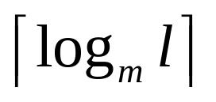

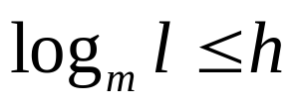
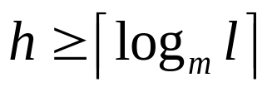
Corollary 1: If an m-ary tree of height h has l leaves, then h ≥ . If the m-ary tree is full and balanced, then h = .
Proof: We know that from Theorem 5. Taking logarithms to the base m shows that
. Since h is an integer, we have .
Now suppose that the tree is balanced. Each leaf is at level h or h-1, and since the height is h, there is at least one leaf at level h.

Slide 51
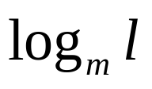
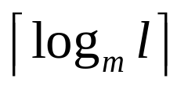
Proof: It follows that there must be more than m^(h-1) leaves.
Since l≤m^h, we have m^(h-1) < l ≤ m^h.
Taking logarithms to the base m in this inequality gives h – 1 < ≤ h.
Hence, h = .

Slide 52
Applications

Slide 53
Applications
1. 假设无向树T有1个3度结点，2个2度结点，其余结点都是树叶，试求树叶数，并画出满足要求的非同构的无向树。

Slide 54
Applications
1. 已知道无向树T中，有1个3度结点，2个2度结点，其余结点都是树叶，试求树叶数，并画出满足要求的非同构的无向树。
解：设有x片树叶，于是结点总数为
n=1+2+x=3+x
由握手定理和树的性质m=n-1可知，
2m=2(n-1)=2*(2+x)=1*3+2*2+x
得到x=3,因此T有3片树叶。
故T的度数应为1、1、1、2、2、3.

Slide 55

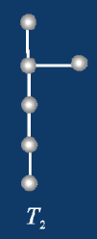
Applications
1. 已知道无向树T中，有1个3度结点，2个2度结点，其余节点都是树叶，试求树叶数，并画出满足要求的非同构的无向树。

Slide 56
Applications
2. 假设无向树T有5片树叶，2度与3度顶点各1个，其余顶点的度数均为4，求T所包含的结点数n，并画出满足要求的所有非同构的无向树。

Slide 57
Applications
2. 已知道无向树T有5片树叶，2度与3度顶点各1个，其余顶点的度数均为4，求T所包含的结点数n，并画出满足要求的所有非同构的无向树。
解：T所包含的边数m=n-1,4度顶点的个数为n-7。
由握手定理得
2m=2(n-1)=5*1+2*1+3*1+4(n-7)
得n=8，因此4度结点的有1个。
故T的顶点度数为1、1、1、1、1、2、3、4。

Slide 58
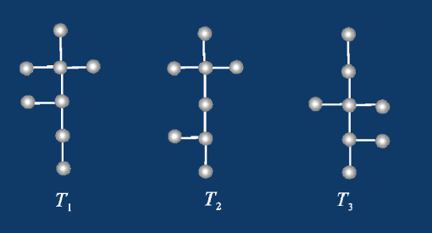
Applications
2. 已知道无向树T有5片树叶，2度与3度顶点各1个，其余顶点的度数均为4，求T所包含的结点数n，并画出满足要求的所有非同构的无向树。

Slide 59
End of Section 7.1
Click to edit company slogan .

